Slide 1
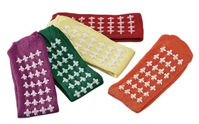
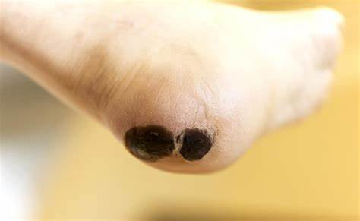
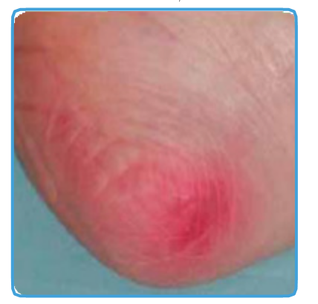
NHSGGC Tissue Viability Service STOP THE PRESSURE 2024
“Are you really looking? are you really listening?” This theme is to encourage us to think about how we communicate with patients and carers to ensure they are making informed choices.
FOOT CHECKS – Non-slip socks should be removed REGULARLY to assess:-
Pressure points
Skin health
Circulation/ABPI
Wound dressings
Foot hygiene
Listen to your patient and families and ask for suitable socks and footwear.
Non-slip socks are not intended to be worn as socks under footwear.
Safe/ suitable footwear is a key intervention in falls reduction and for rehabilitation.

